Slide 1
ENR-325/325L Principles of Digital Electronics and Laboratory
Xiang Li
Fall 2025

Slide 2
A homemade MOSFET:
https://www.youtube.com/watch?v=IS5ycm7VfXg

Slide 3
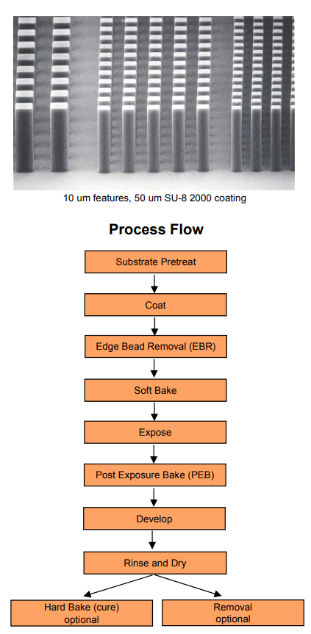
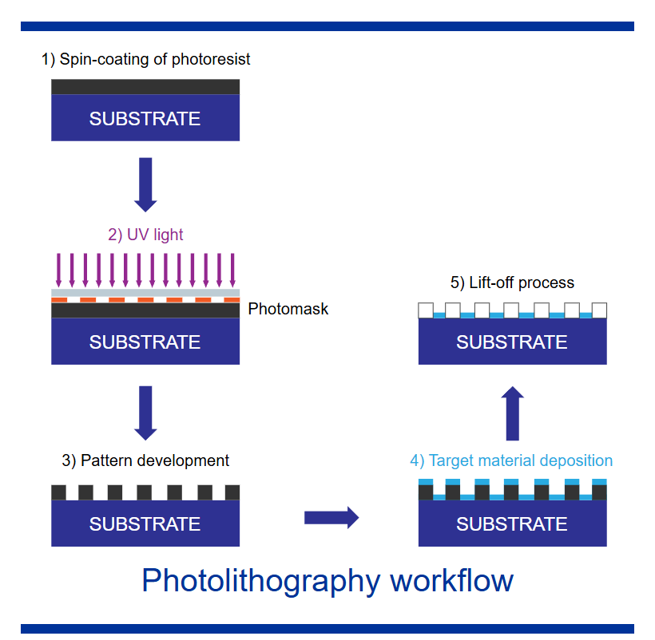
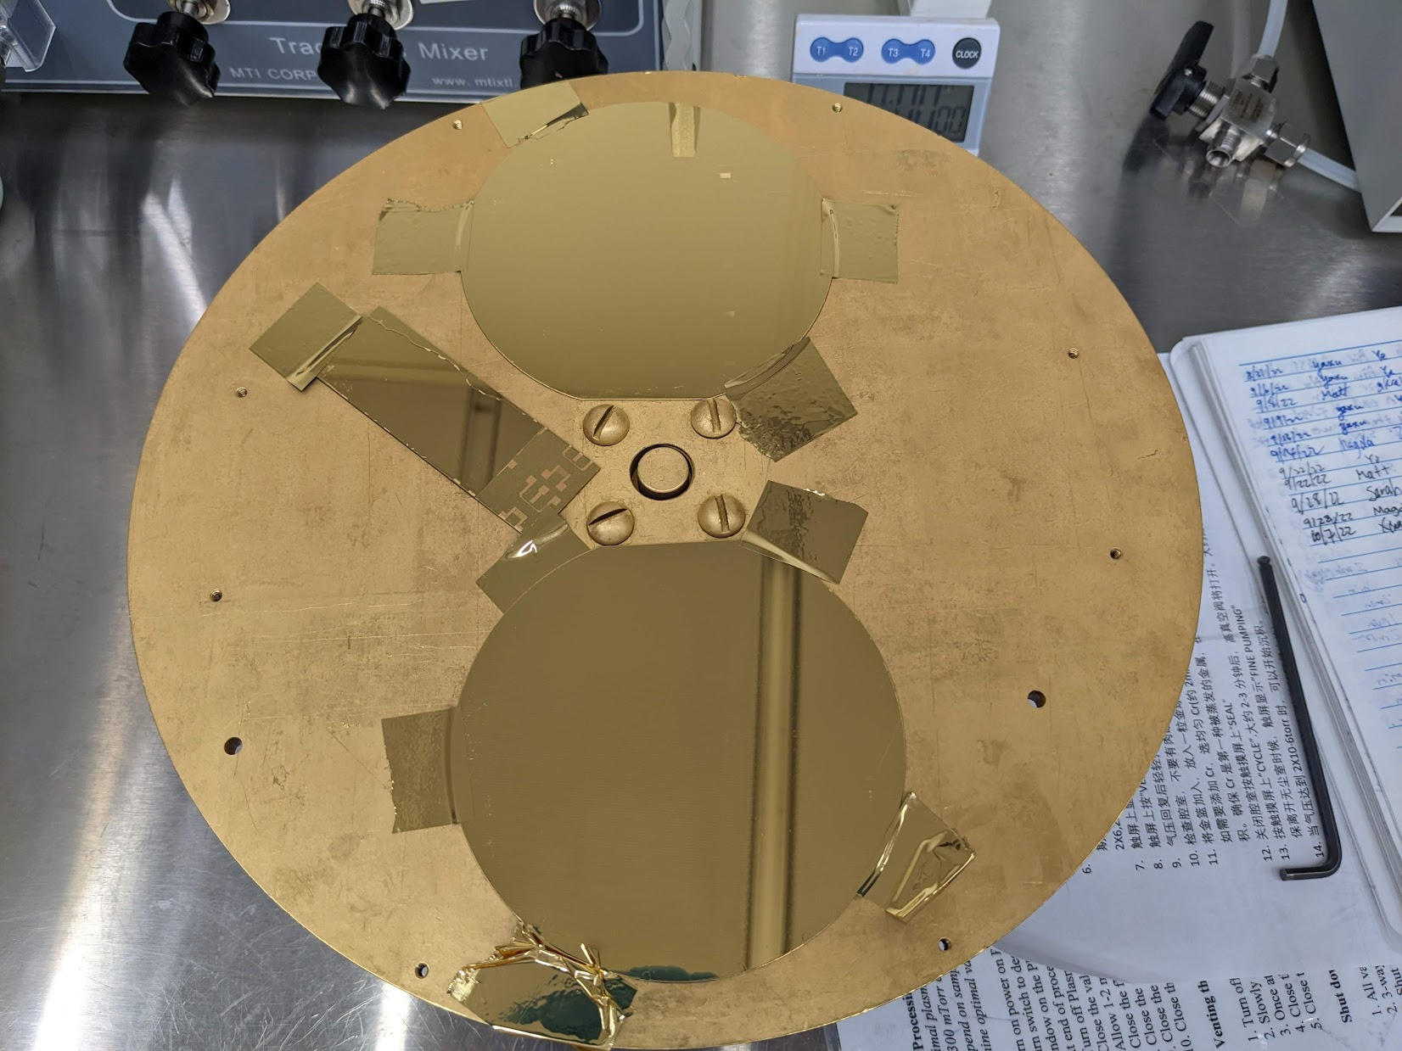
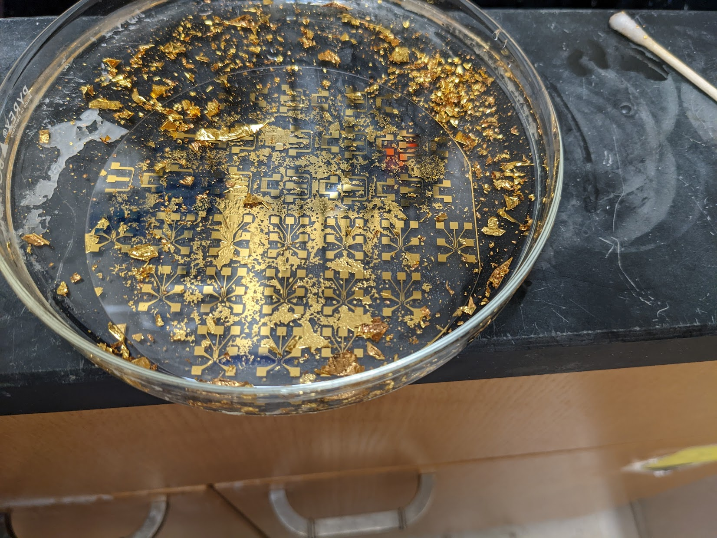
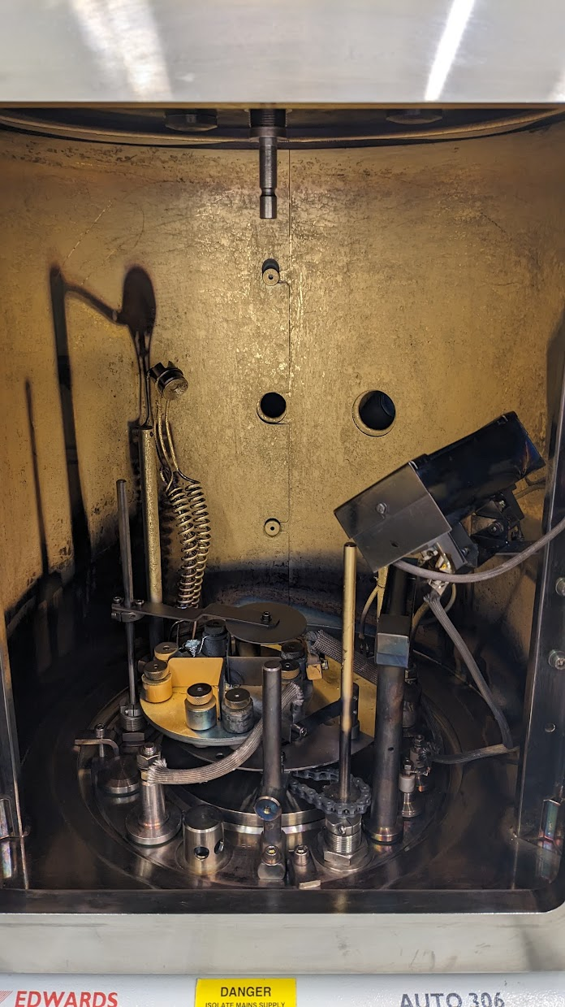
The realm of process engineering (1/2)
Photolithography example: lift-off
Data sheet and process flow from Kayaku and Kurt J. Lesker
Fabrication process at Indiana University cleanroom, 2021

Slide 4
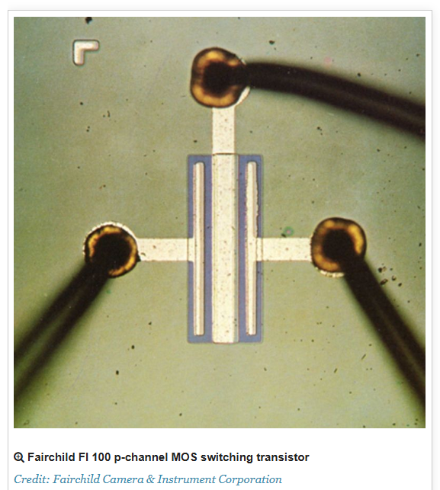
Discuss: mask design for electrodes:

Slide 5
Discuss: mask design for electrodes:
Which mask?

Slide 6
Discuss: mask design for electrodes:
Which mask?
Depends on the types of PR, actually.

Slide 7

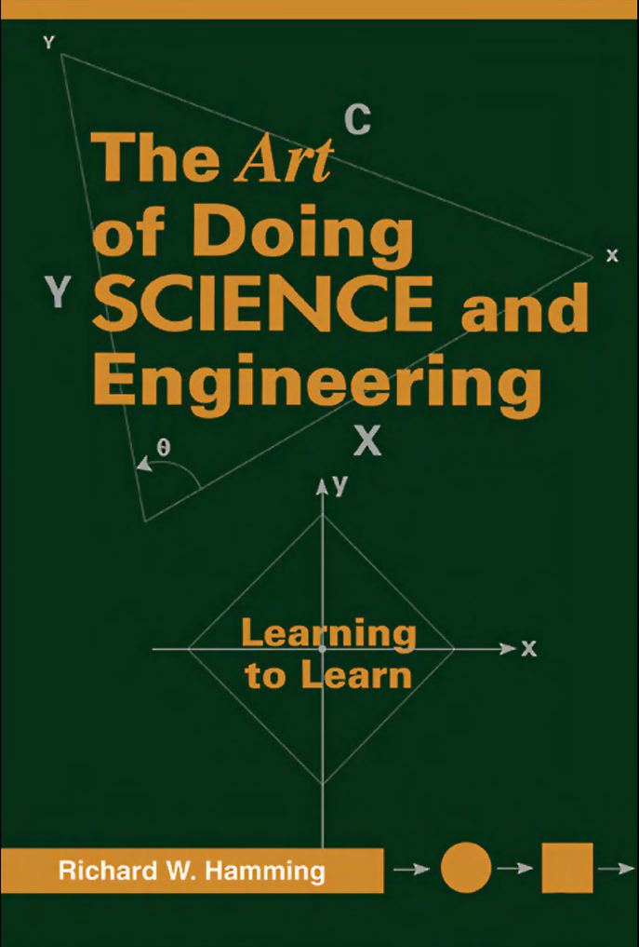
The realm of process engineering (2/2)
How could we manage the thickness control back in the 60-70s (1nm precision and 0.1 nm resolution) ?

Slide 8
The realm of process engineering (2/2)
How could we manage the thickness control back in the 60-70s (1nm precision and 0.1 nm resolution) ?
1. Good vacuum pump

Slide 9
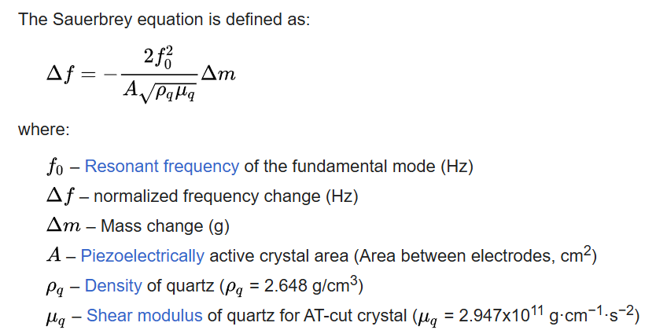
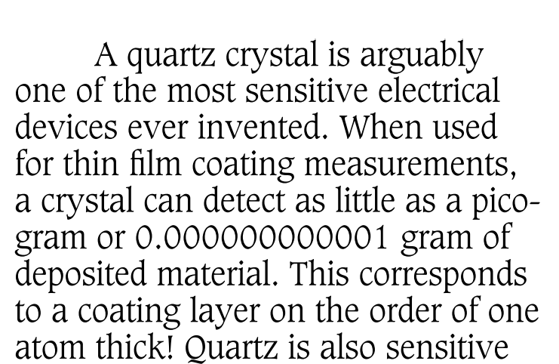
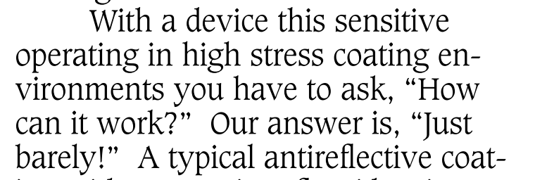
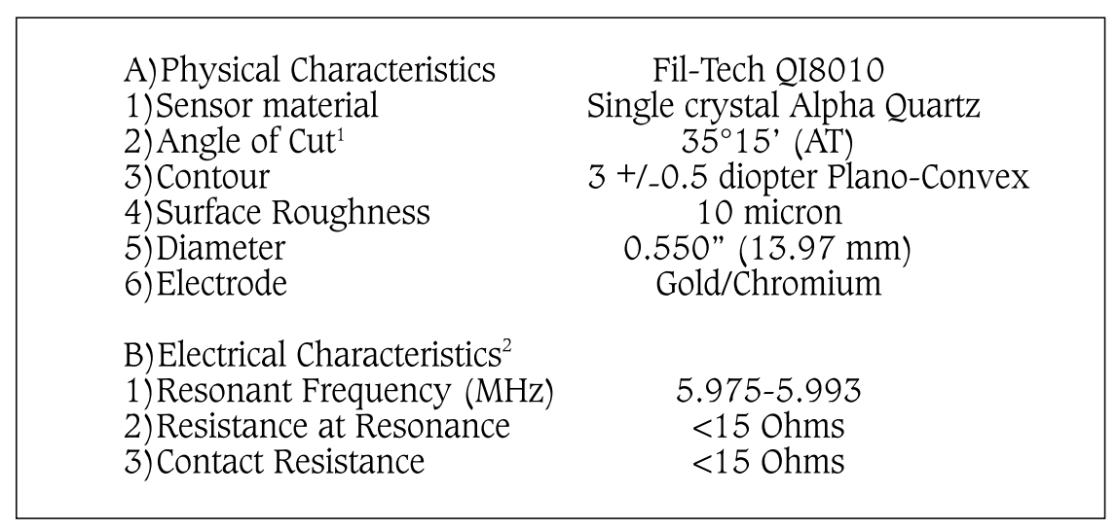
The realm of process engineering (2/2)
2. (Quartz Crystal Microbalance (QCM) sensor)
Typically a 6 MHz crystal, and runs until there’s a 1.50 MHz shift.
Tech bulletin from the QCM vendor, Fil-Tech inc.

Slide 10
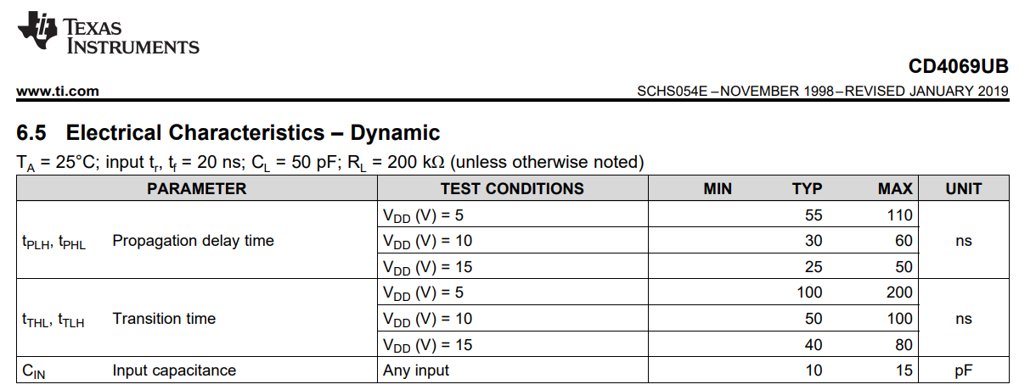
Transient parameters
Theoretical:
Vin
VIH
VIL
t
Vout
VOH
VOL
t

Slide 11
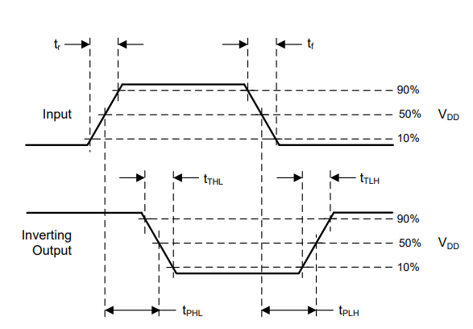
Transient parameters
Practical:
Vin
VIH
VIL
t
Vout
VOH
VOL
t

Slide 12
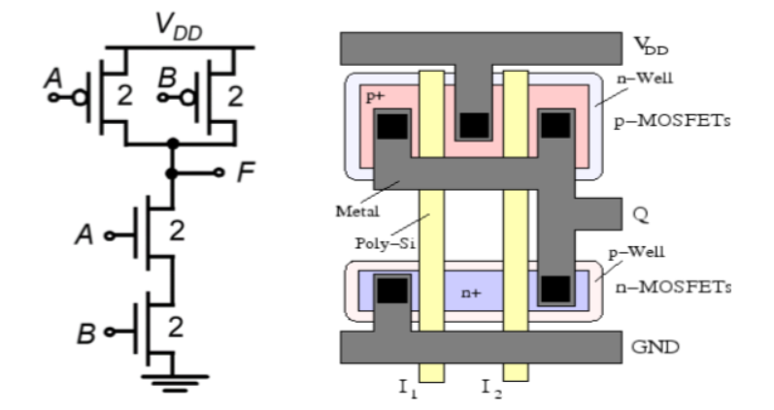
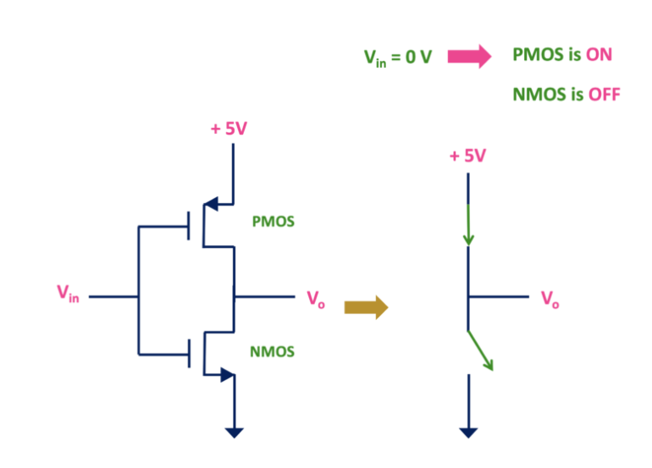
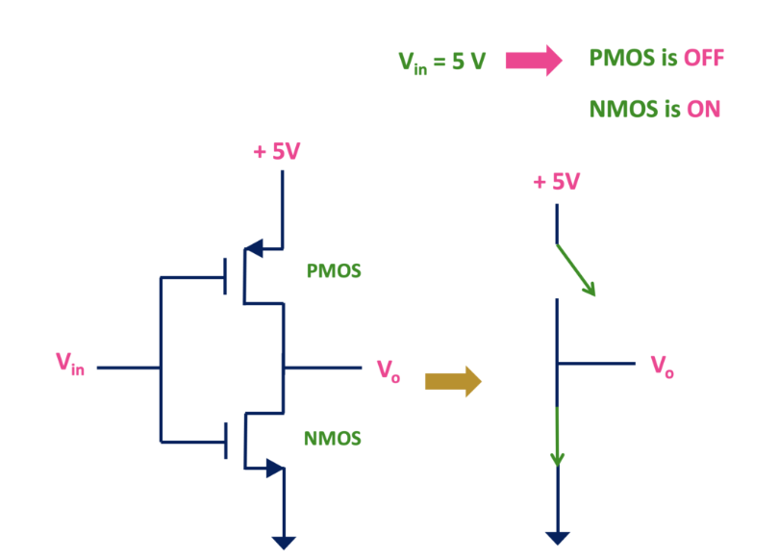
One more step: CMOS NAND gate
https://www.tutorialspoint.com/vlsi_design/vlsi_design_combinational_mos_logic_circuits.htm

Slide 13
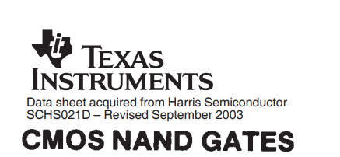
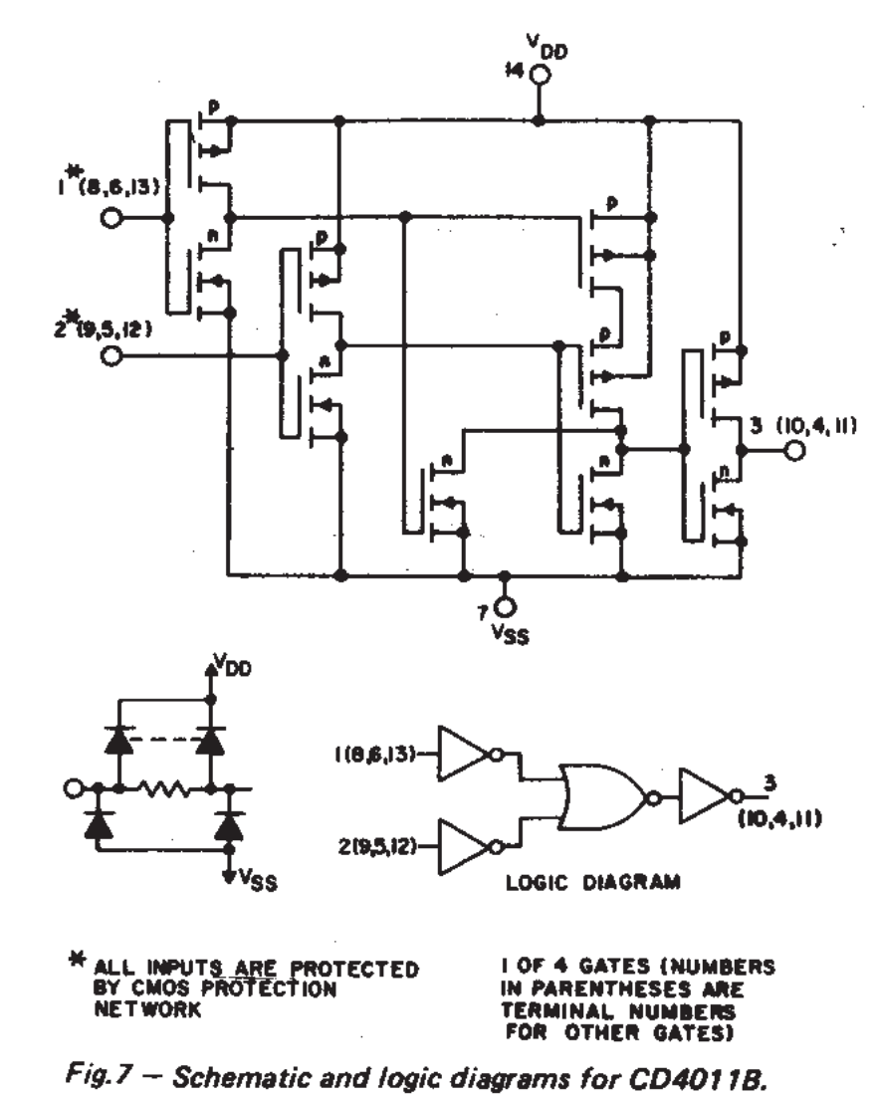
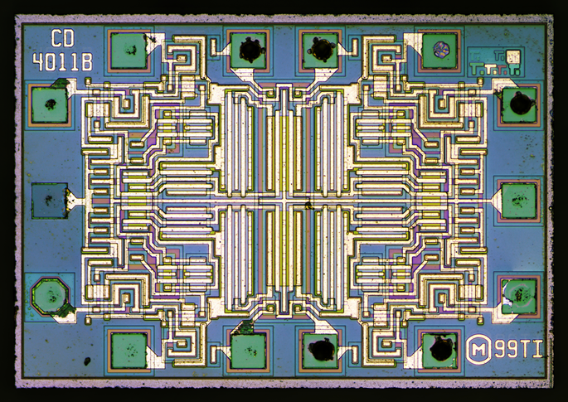
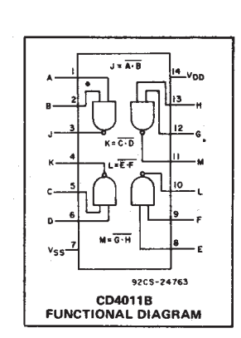
CMOS NAND gate
1
2
3

Slide 14
Identify the NAND gate
1
2
3

Slide 15
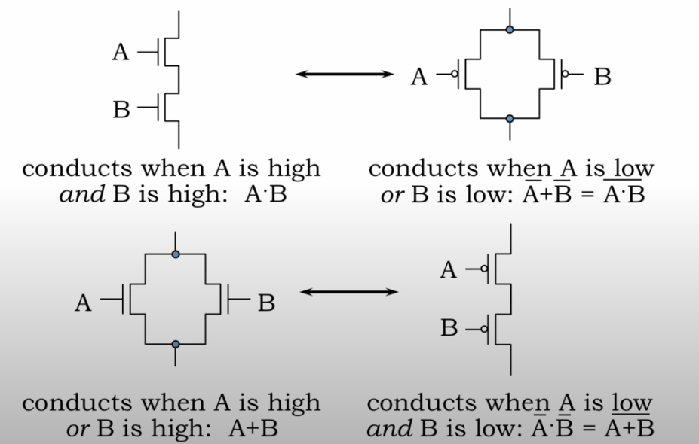
C is for complementary
Vdd
Vin
Pull up
CMOS design, no need for truth table?
Vout
Vin
Pull down
O = (A+B)·C
Pull up (PMOS)
Pull down (NMOS)
(A·B)+C
O = (A+B)·C
MIT 6.004

Slide 16
C is for complementary
CMOS design without truth table
O = (A+B)·C
Vdd
A
C
Pull up (PMOS)
B
Vout
A
B
Pull down (NMOS)
C
MIT 6.004

Slide 17
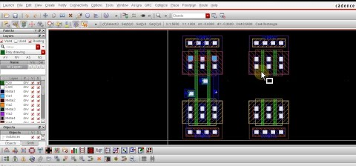
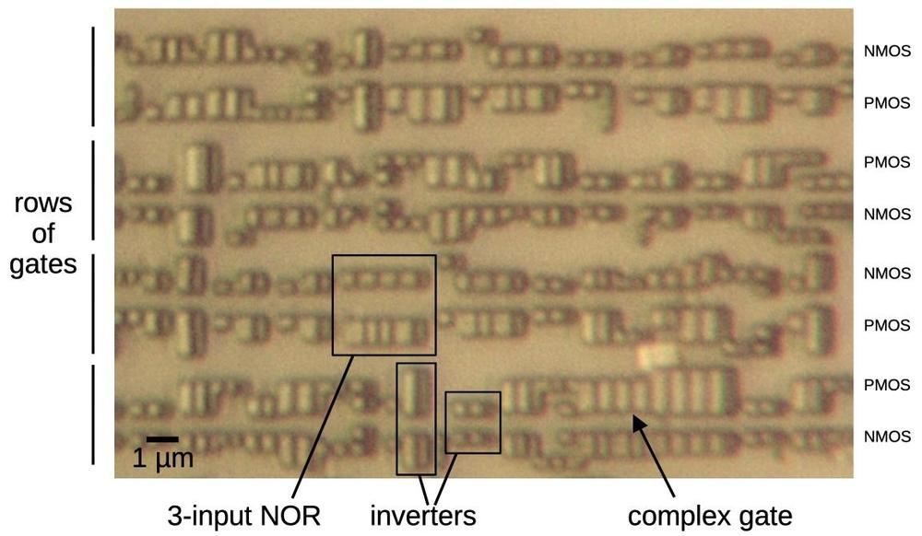
CMOS design for large circuitry
Foundry
(TSMC, Intel, etc)
Chip design
(Apple, Qualcomm, etc)
Logic, verification, and physical design for fab
Standard cell library
EDA
(Cadence & Synopsys, etc)
Standard cell logic form a 180 nm CMOS chip in the 90s
1
2
3
https://www.righto.com/2024/06/montreal-mifare-ultralight-nfc.html

Slide 18
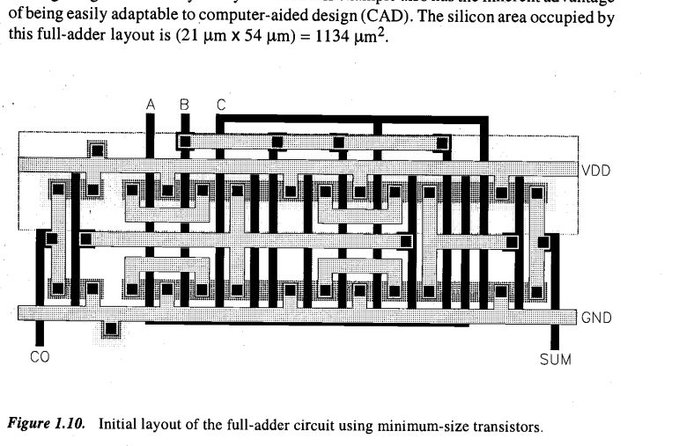
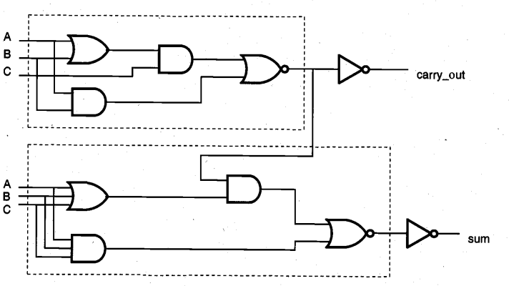
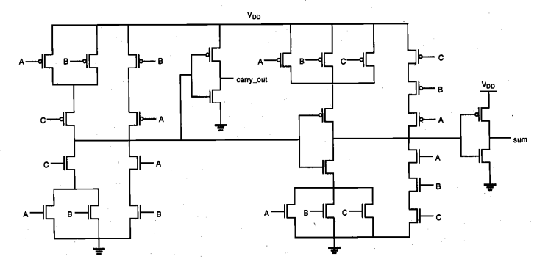
CMOS design rules shown as a full-adder
Gates
Power supply
PMOS
NMOS
Ground
Mano, M. Morris. Digital logic and computer design. 1979

Slide 19
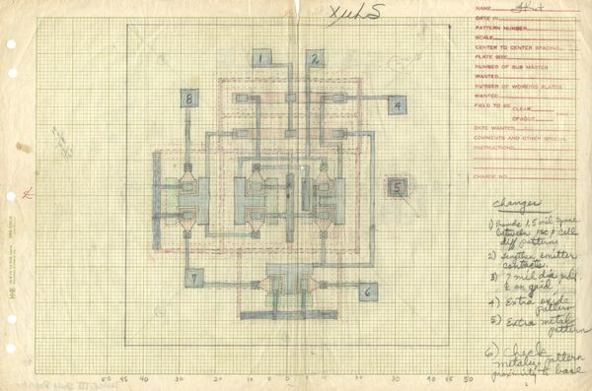
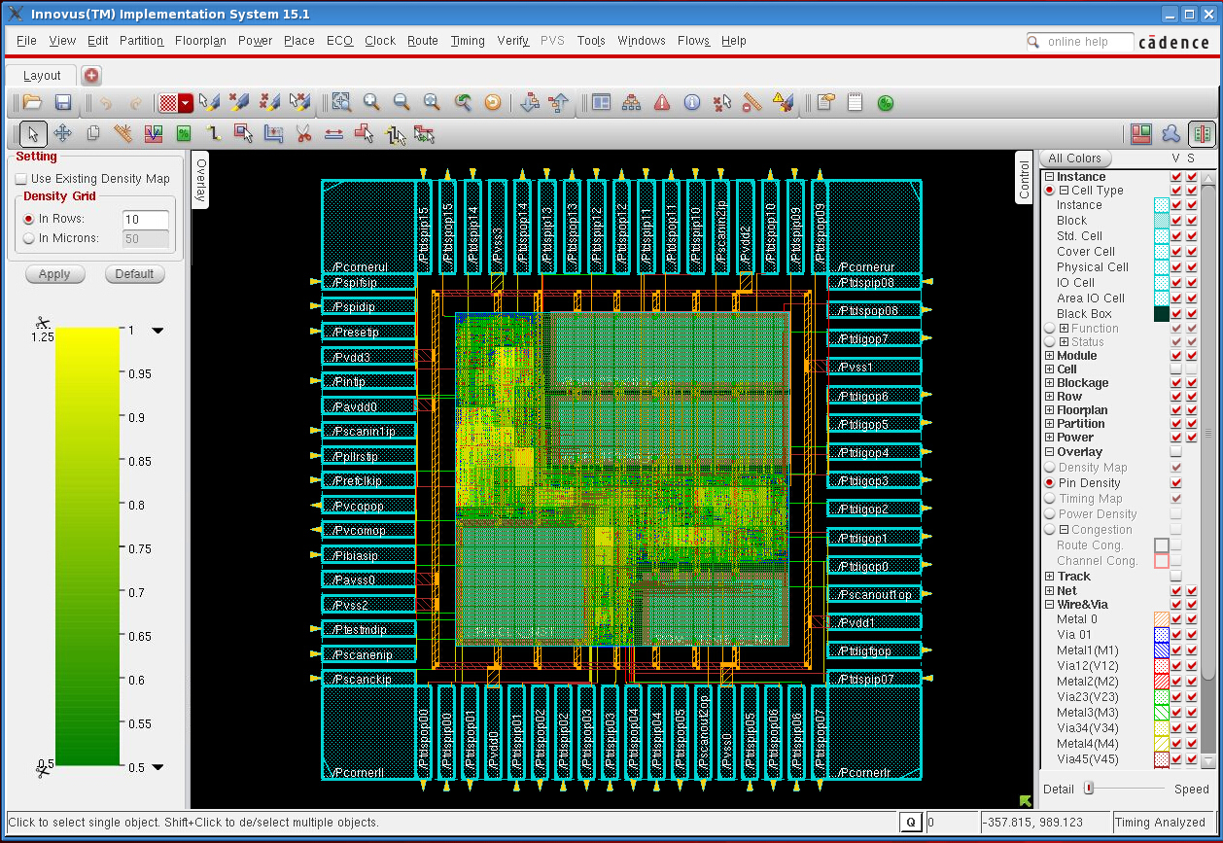
Design our own IC, yes we can!
The general process flow
IC spec
Circuits design
Physical design
Test and sign off
High level requirements
Customer needs
Logic circuits
Memory circuits
Netlist of every groupings
Hand draw mask layout, Fairchild 1960
https://www.computerhistory.org/revolution/digital-logic/12/287
cadence

Slide 20

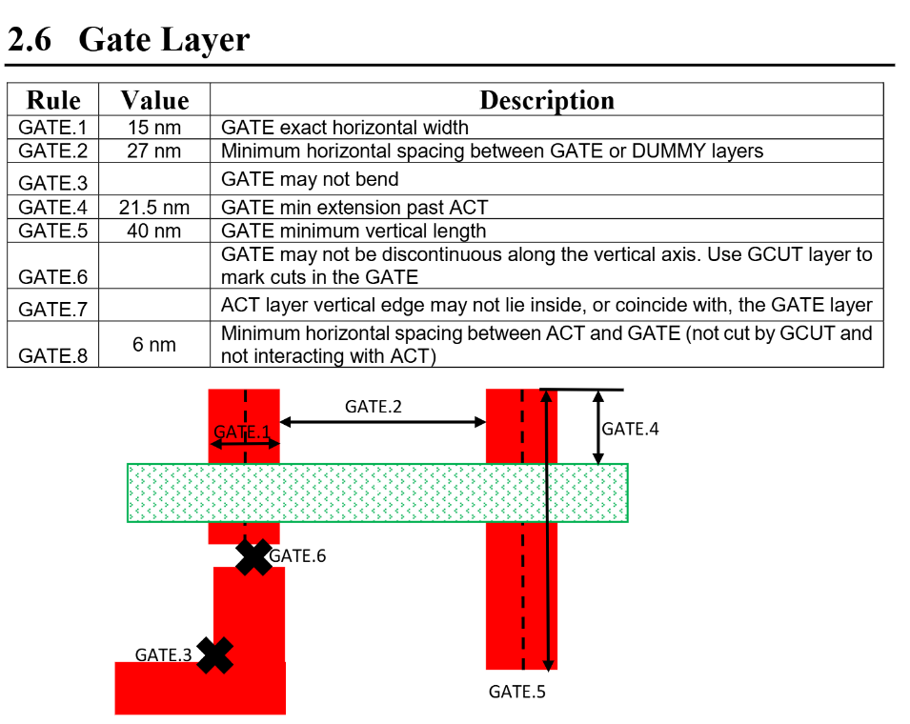
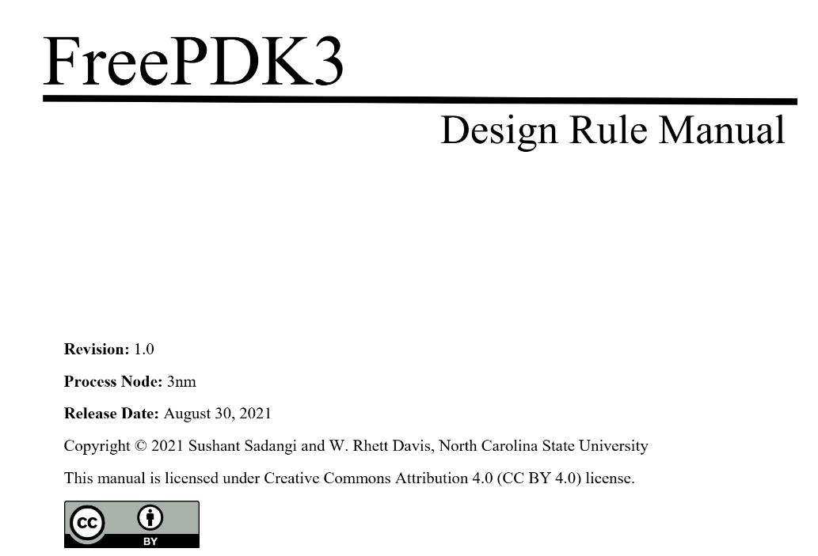
Design our own IC, yes we can!
https://tinytapeout.com/siliwiz/
https://app.siliwiz.com/
PDK are design rules set by the foundry. With opensource support, it is technically possible to generate a design file (GDS) and get your IC chips fabricated.
https://github.com/ncsu-eda/FreePDK3
Example of design rules from FreePDK3 by NCSU, 2021

Slide 21
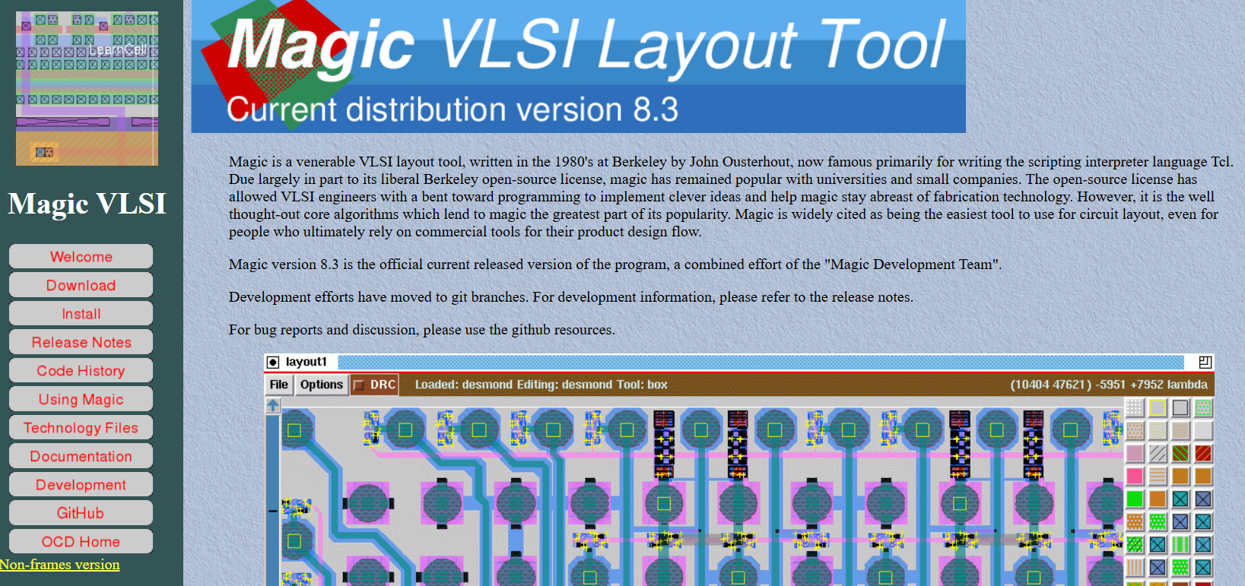
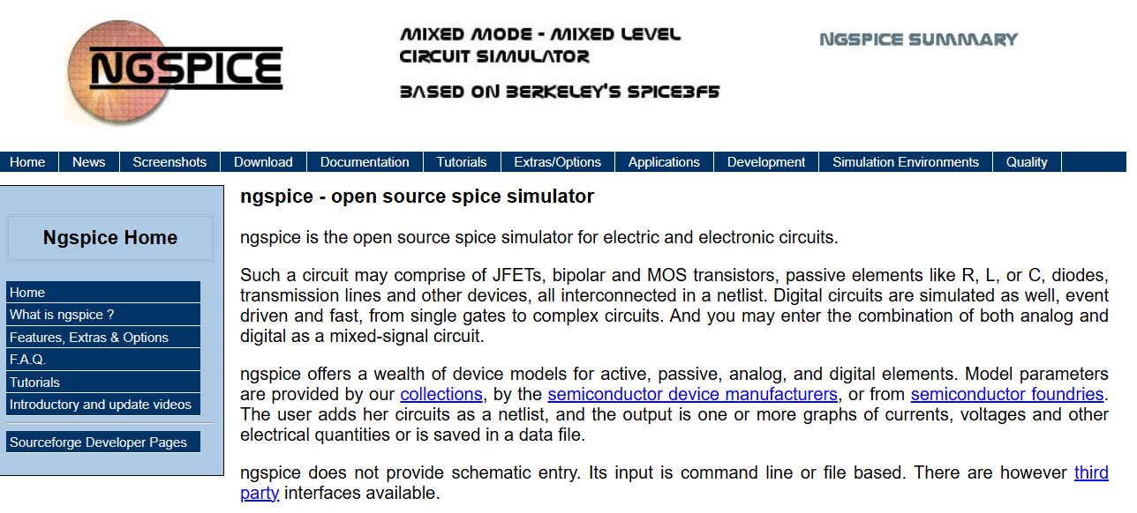
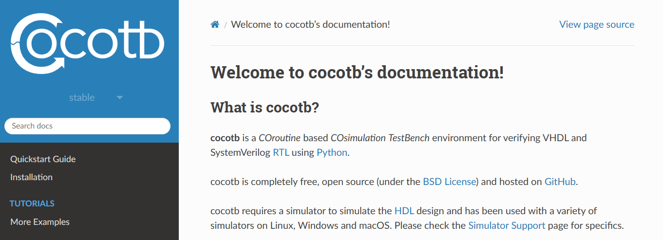
Into the realm of digital design

Slide 22
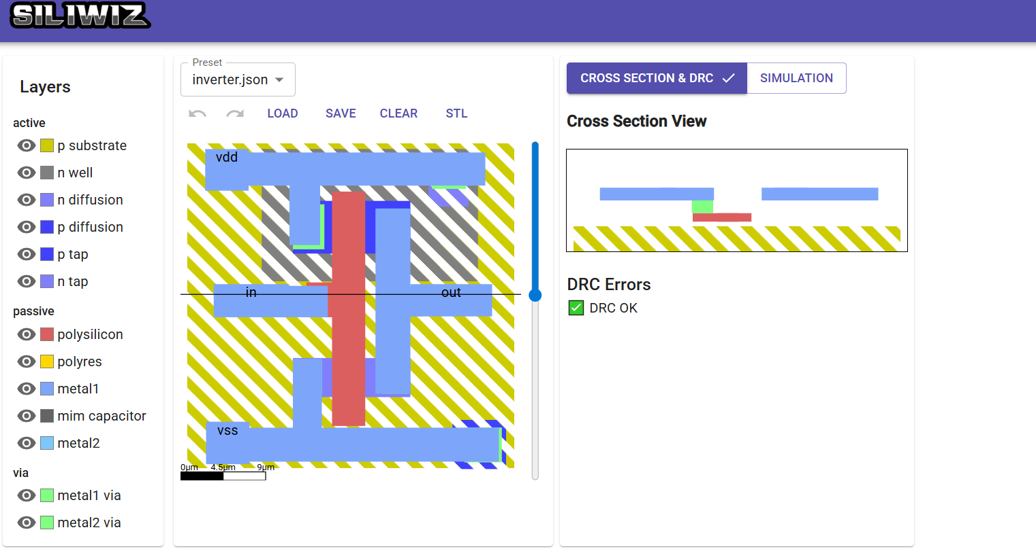
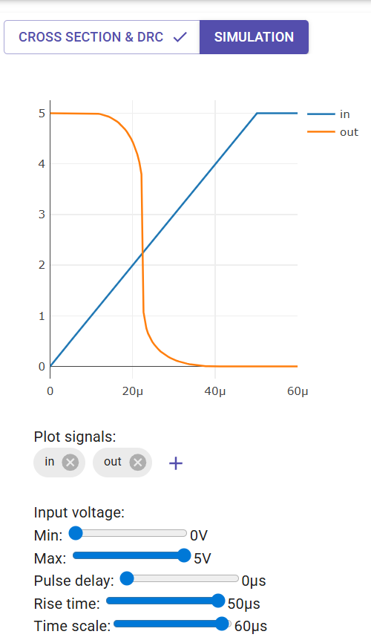
Into the realm of digital design
https://app.siliwiz.com/

Slide 23
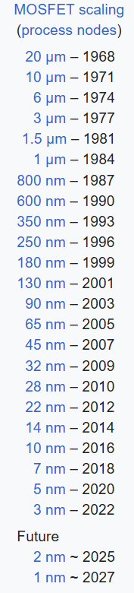
The state of the art for CMOS:
The “nm” race
First FinFET fabrication by Hitachi
First FinFET chip by Intel
TSMC starting chip supply (SoC) to Apple
GlobalFoundries (AMD) stopping R&D
TSMC FinFET mass rollout
TSMC leading

Slide 24
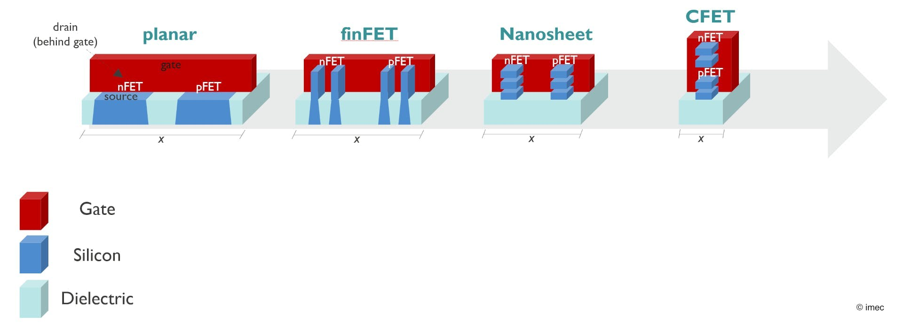
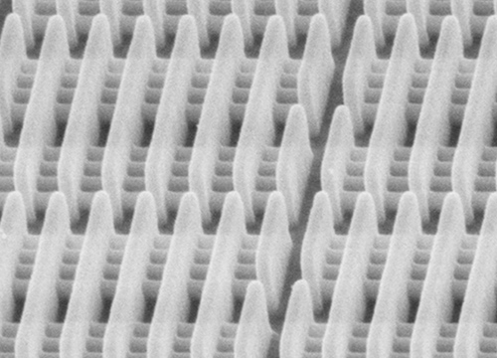
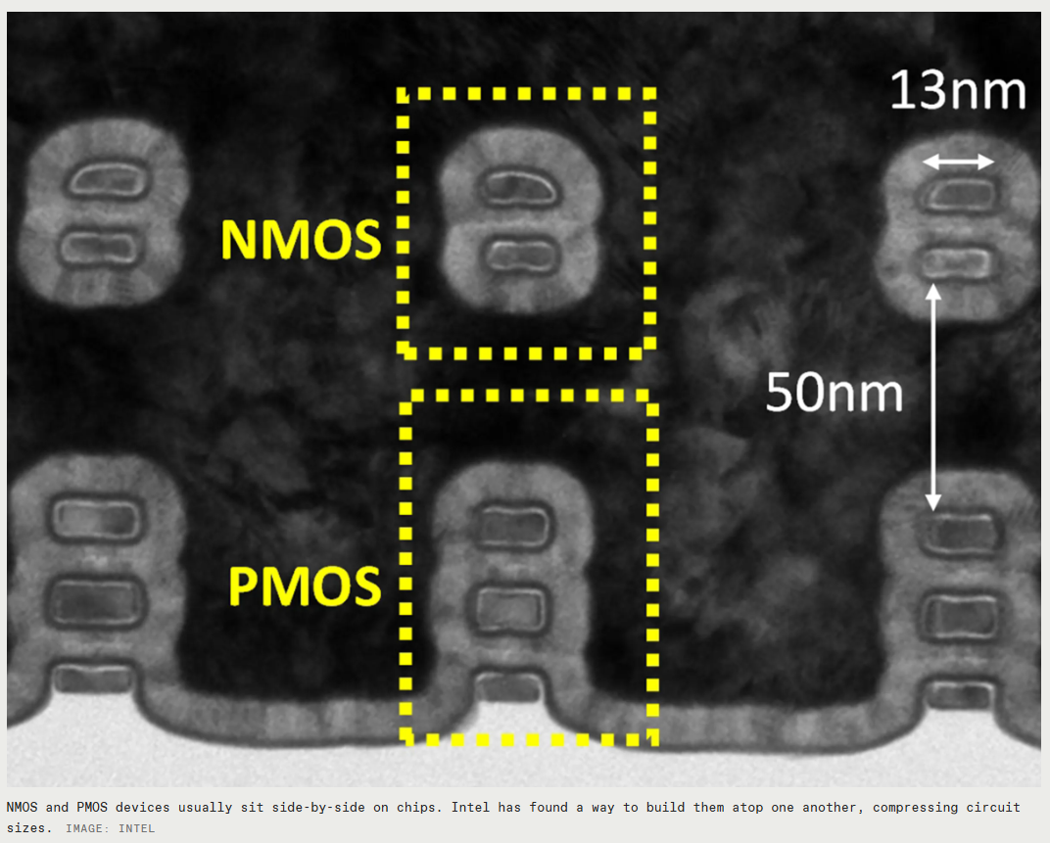
The state of the art for CMOS:
The “nm” race
Future? (<5nm)
https://www.electronicdesign.com/
16nm Fin Field Effect Transistor, TSMC
Nanosheet inverter, Intel reported in 2020
https://spectrum.ieee.org/

Slide 25
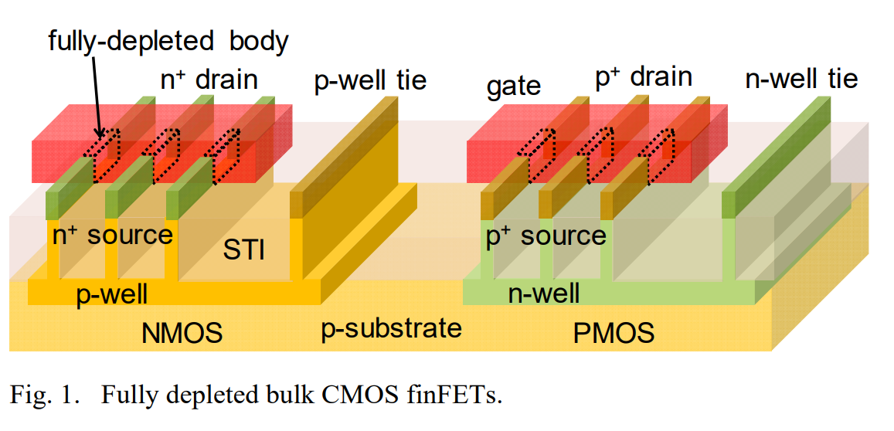
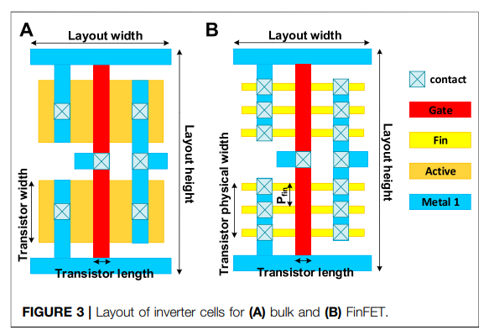
FinFET
(i.e. no doping here)
Gate
Fin stack
DOI:10.1109/CICC.2018.8357060
CMOS inverter layout example
PMOS
The dimension of the fin is confined by the foundry (TSMC).
The number of the fin can be adjusted to get different gate current.
The fin stacks and gate can then be cut or connected.
NMOS
DOI: 10.3389/frai.2021.659060

Slide 26
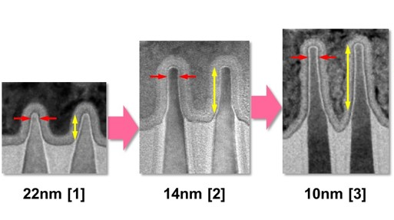
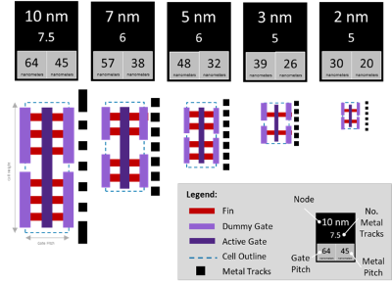
FinFET iteration
Tall fin
Fin depopulation
Intel 2017
Intel 2014
Intel 2012
https://semiengineering.com/selective-removal-for-stronger-fins/
https://www.eetimes.com/what-to-expect-at-5-nm-and-beyond-and-what-that-means-for-eda/

